Slide 1


Securing Exam Paper
Transmission in Academic Institutions

Slide 2
In todays world there a big question about secuirty...
what if someone steals an exam paper..??
Problem
In our current world we use i.e the colleges and the institutions use:
RSA(fro key exchange)
AES(for evcryption)
HTTPS/VPN-bnased secure transfer
These all rely on CLASSICAL CRYTOGRAPHY
But nonethless security is based on:
Mathematical hardness assumptions
Statment
Here, The Probleem arises such that
RSA can be broken by quantum computers using Shor’s algorithm.
No built-in eavesdropping detection is implemented.
If key is intercepted and then system does not know.
Insider or interception attacks are hard to detect.

Slide 3
Objectives
“We are not replacing classical security — we are strengthening it with quantum-aware key distribution”
To design and evaluate a quantum-based secure key distribution system for protecting exam paper transmission in academic institutions.
Implement the BB84 protocol for secure key generation.
Simulate quantum key exchange using Qiskit.
Measure and evaluate security performance using Quantum Bit Error Rate (QBER).
Compare classical key distribution with quantum key distribution.
Develop a hybrid model integrating quantum key distribution with AES encryption.

Slide 4


Implementation
Details
Existing Classical Model
Flow: Key Generation → AES Encryption → Network Transmission → Decryption
Limitation:
• No intrusion detection
• Depends on computational security
Proposed Quantum Model (BB84-Based)
Tools Used: Qiskit
Workflow:
Alice encodes random bits using random bases (Z/X)
Qubits transmitted through simulated noisy channel
Bob measures using random bases
Basis reconciliation (keep matching bits)
Compute QBER
• Low QBER → Secure
• High QBER → Intrusion detected
Final Step – Hybrid Integration
Generated quantum key → Used in AES encryption for exam paper file

Slide 5
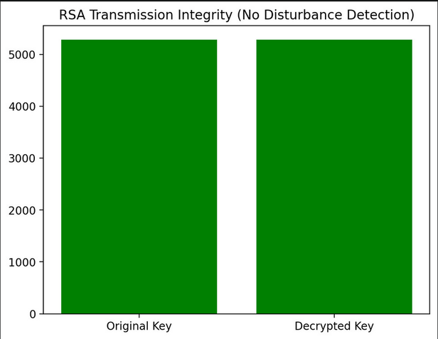
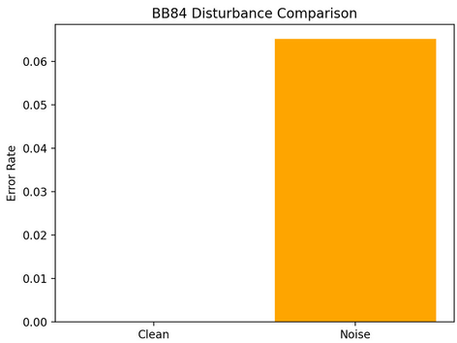
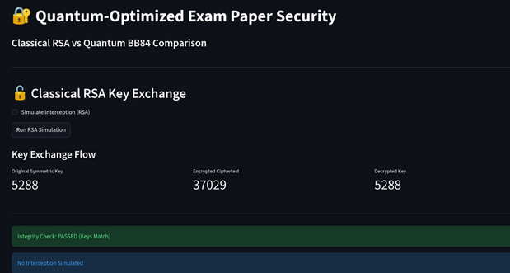
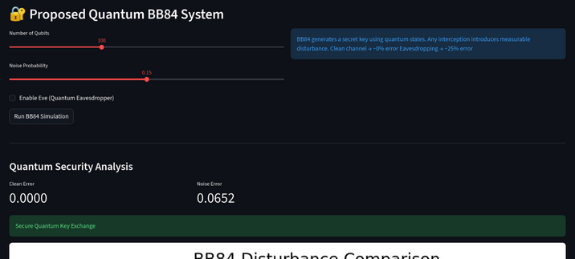

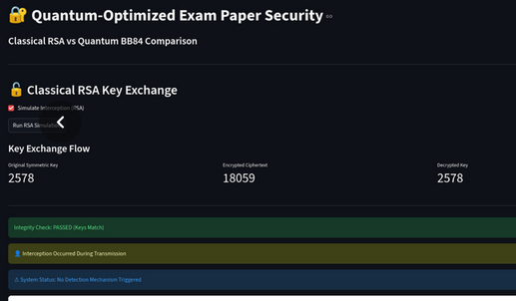
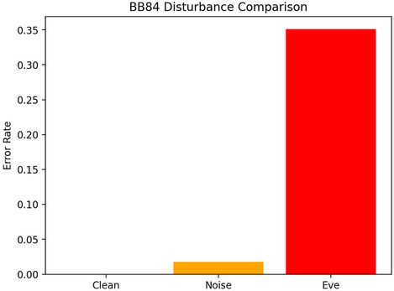
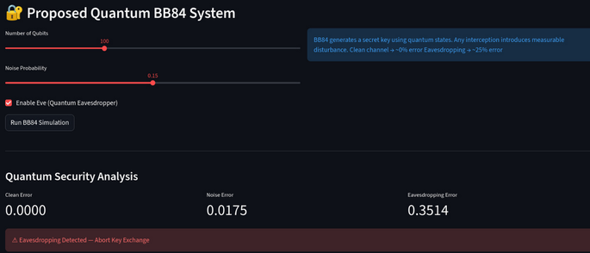
Results & Comparison
Classical systems
Quantum systems
Classical systems
Quantum systems

Slide 6
Analysis, Conclusion & Future Scope
Analysis
Classical systems
BB84 Advantage
Secure today, but vulnerable to future quantum attacks (Shor’s algorithm threat).
Security based on laws of quantum physics, not mathematical assumptions.
QBER = Intrusion Indicator
Noise Impact
Low QBER → Secure
High QBER → Eavesdropping detected
Performance degrades with noise, but remains secure below threshold.
Conclusion
Future Scope
Our Hybrid Security Model:
Quantum Key Distribution using BB84
AES-based classical encryption
Built-in intrusion detection
Future-ready framework for academic institutions
“Combining physics-based security with practical encryption strengthens institutional data protection.”
Test on real quantum hardware (IBM Quantum)
Add quantum error correction
Extend to secure campus-wide communication
Compare with post-quantum cryptographic methods

